Slide 1

DARSHINI S

Slide 2

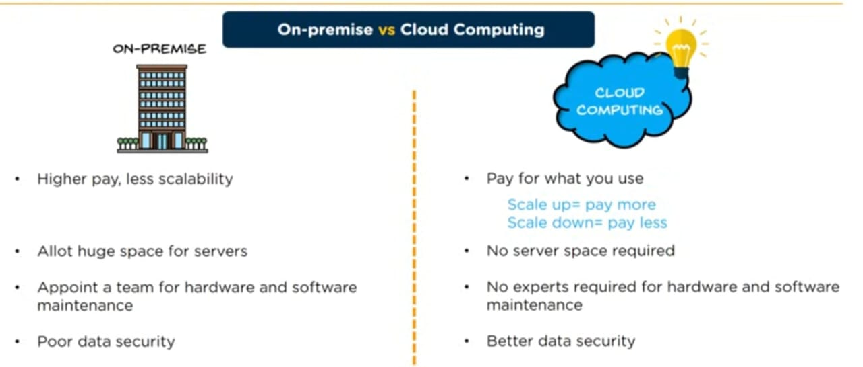
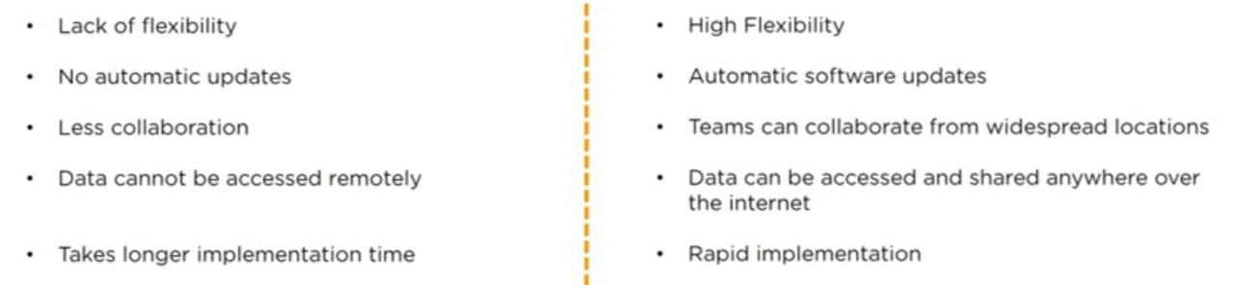
WHY CLOUD COMPUTING

Slide 3

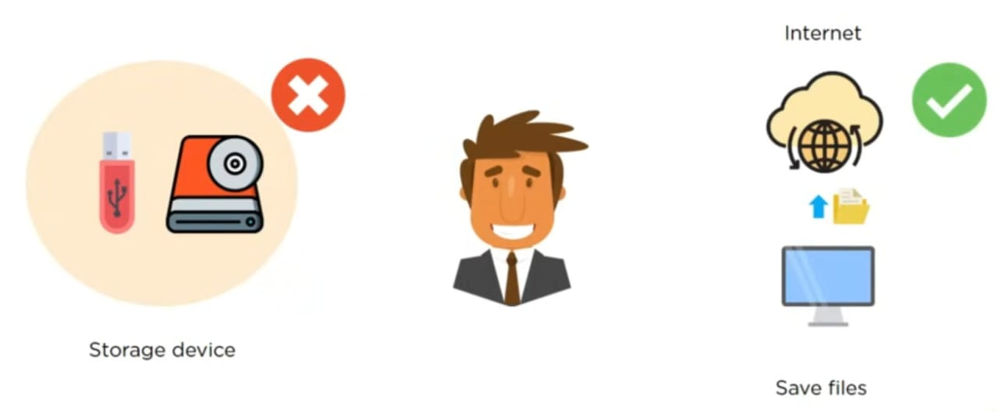
WHAT IS CLOUD COMPUTING
Cloud computing is the delivery of on-demand computing services over the internet on a pay-as-you-go basis.
Rather than managing files on a local storage device, cloud computing makes it possible to save them over internet.

Slide 4
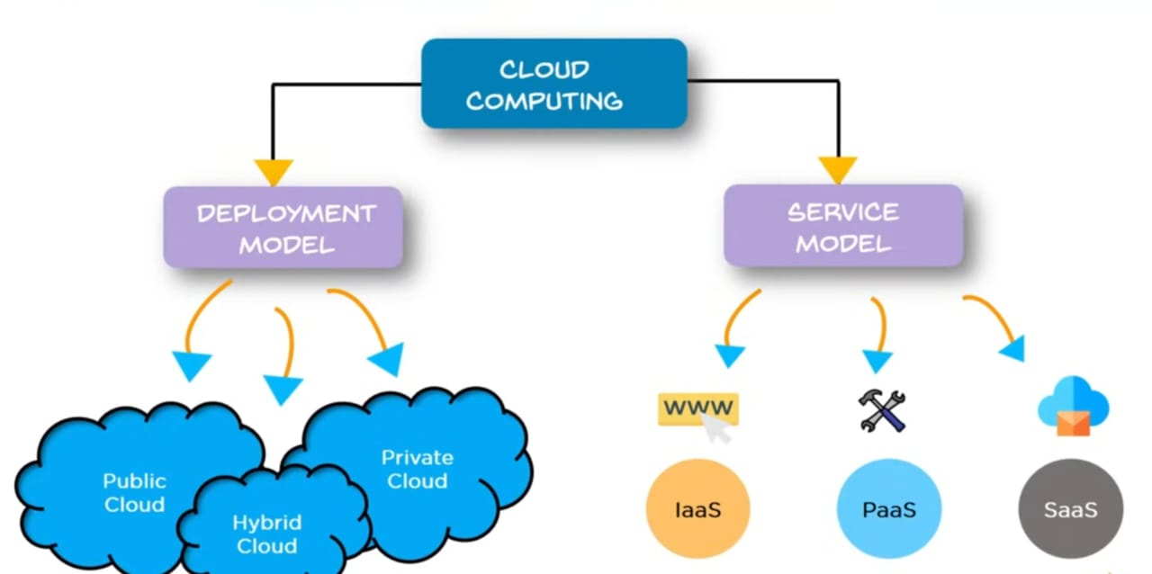
TYPES OF CLOUD COMPUTING

Slide 5
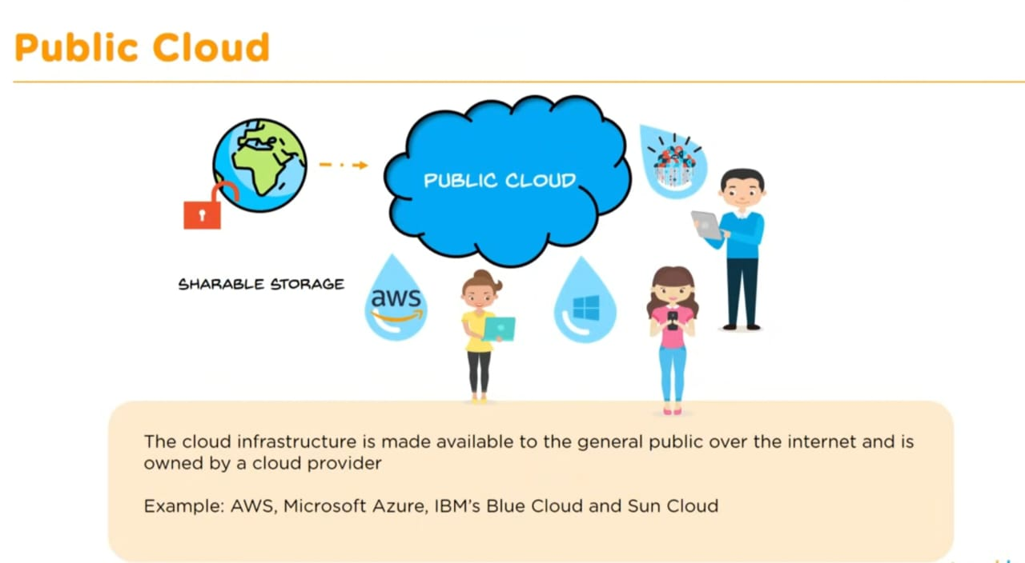
DEPLOYMENT MODEL

Slide 6
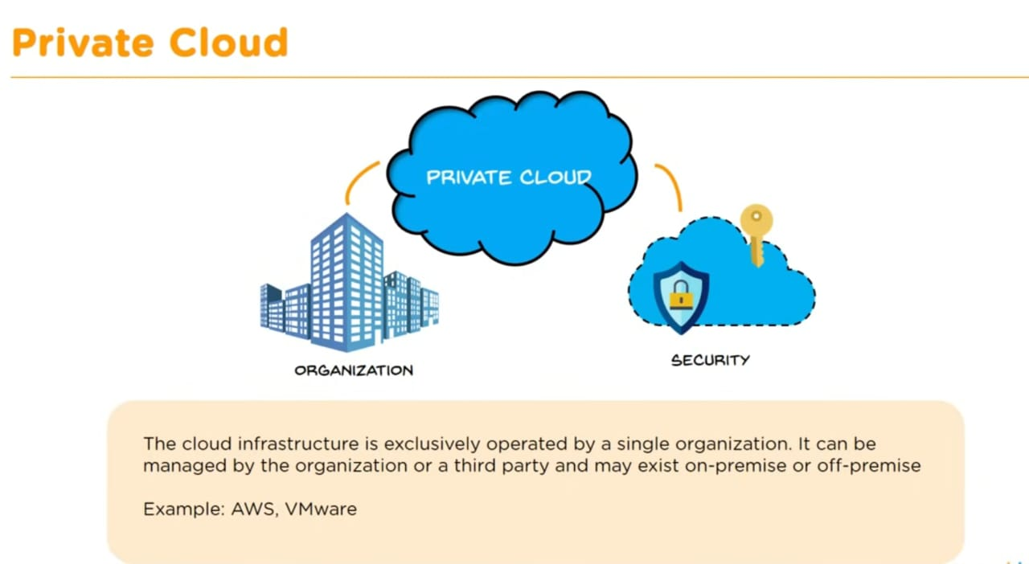
DEPLOYMENT MODEL

Slide 7
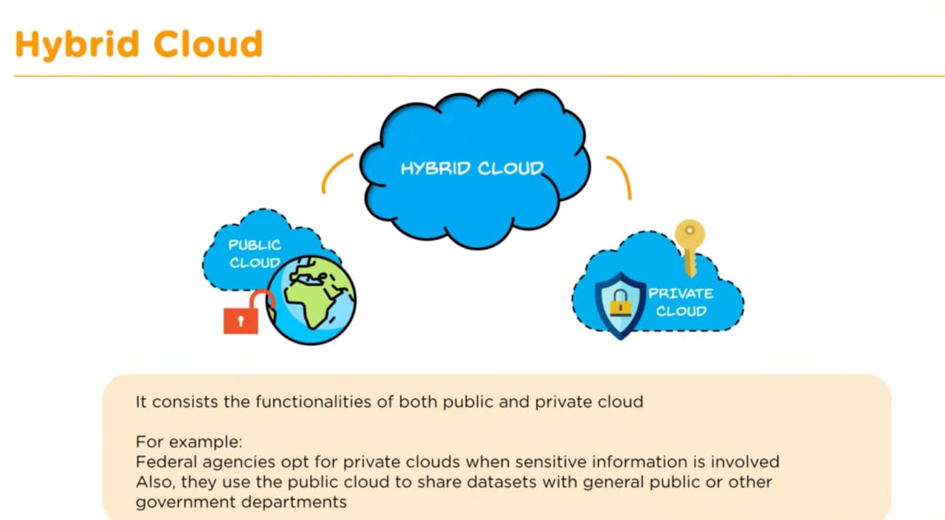
DEPLOYMENT MODEL

Slide 8
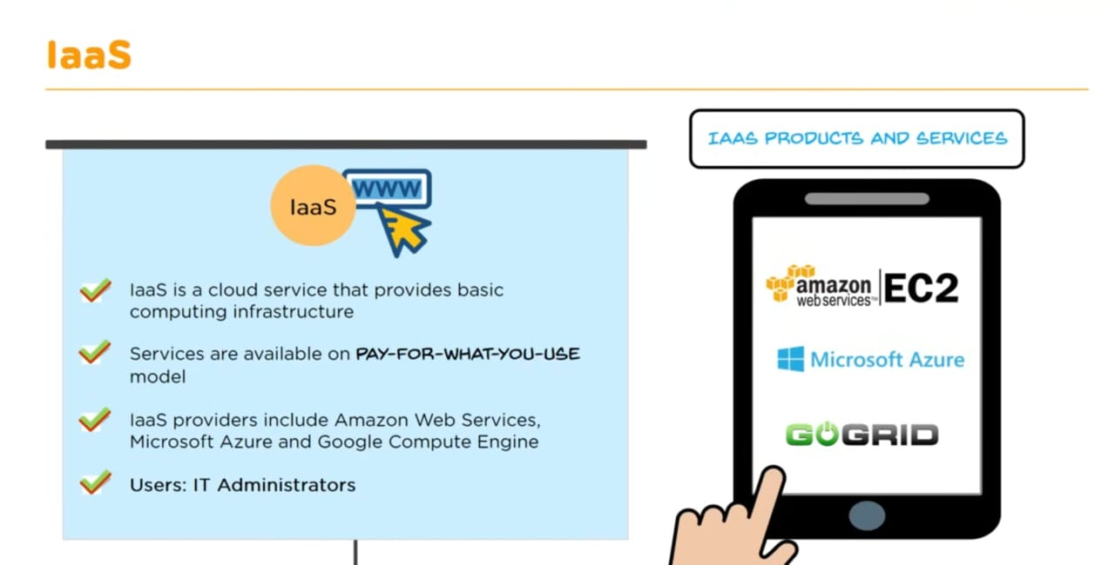
SERVICE MODEL`

Slide 9
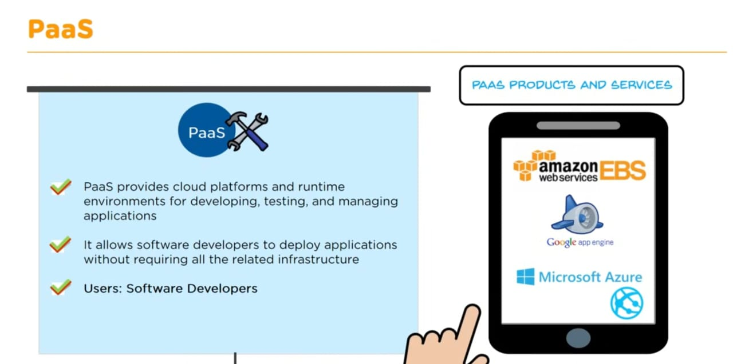
SERVICE MODEL

Slide 10
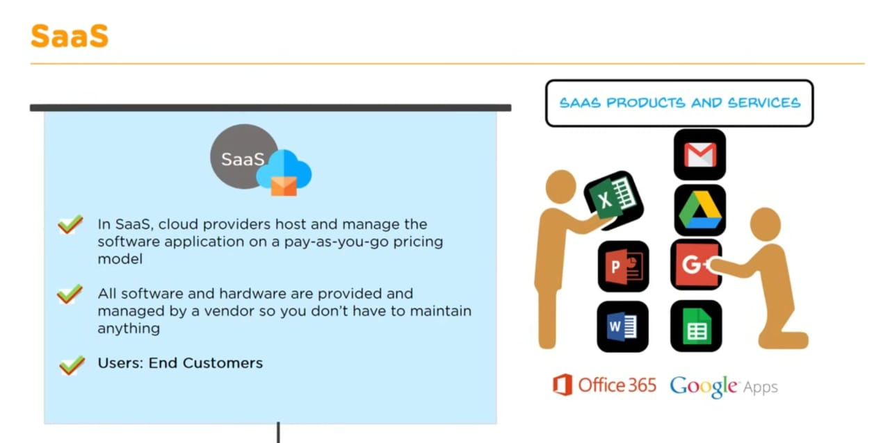
SERVICE MODEL
.

Slide 11
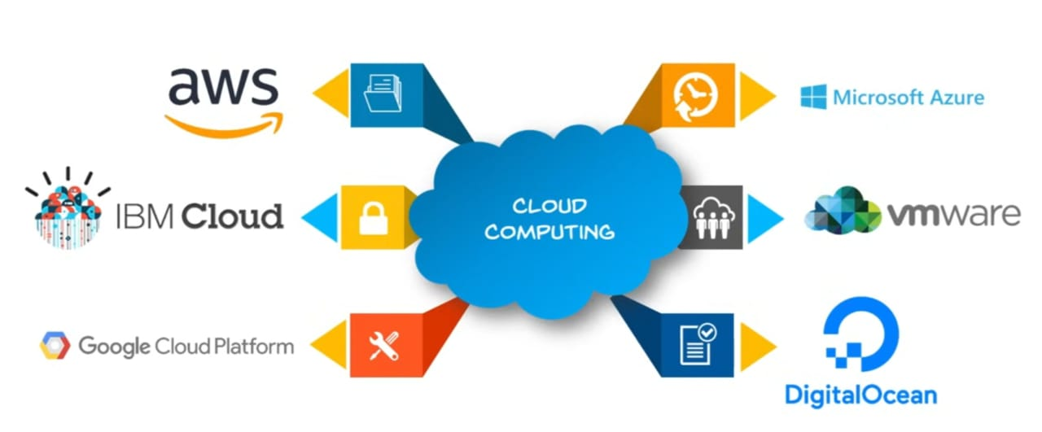
CLOUD PROVIDERS

Slide 12
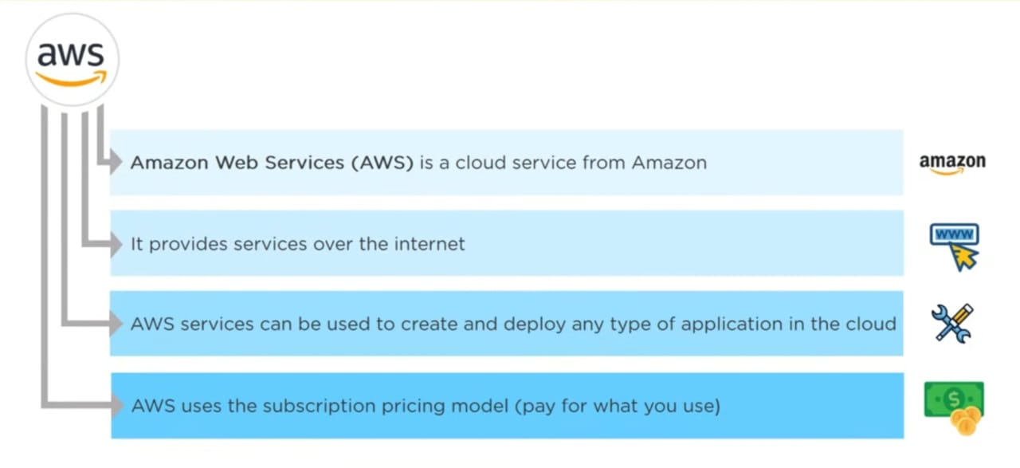
CLOUD COMPUTING WITH AWS

Slide 13
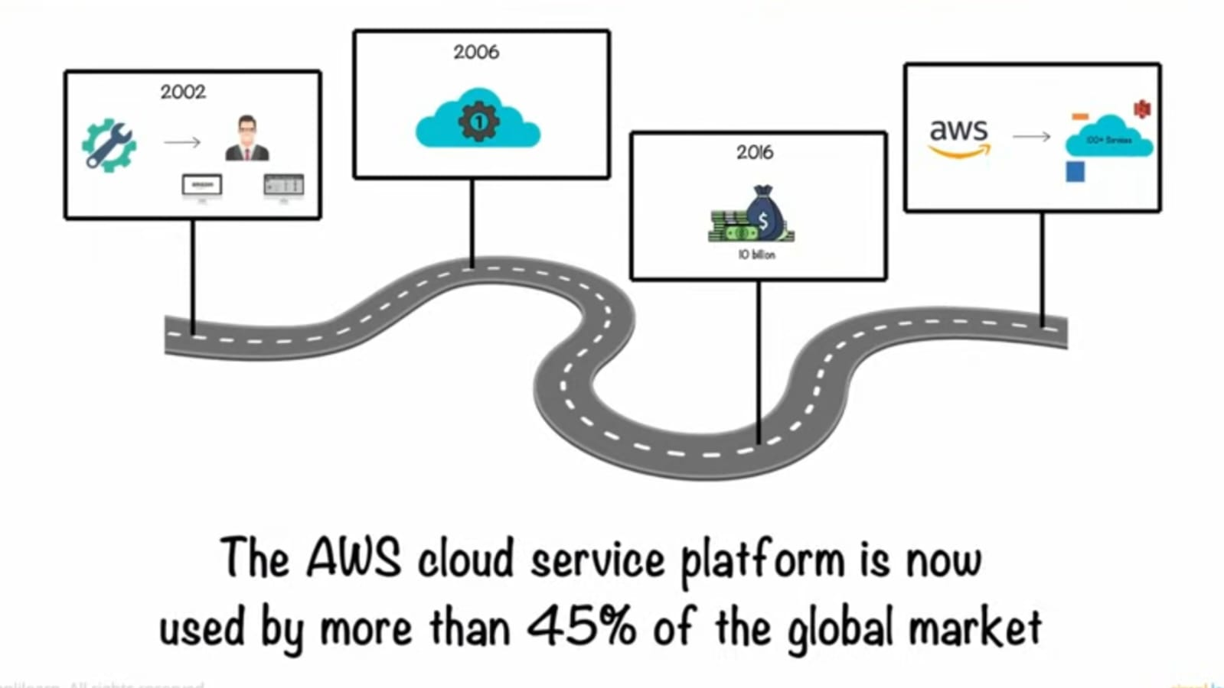
HOW AWS REACHED THE POSITION

Slide 14
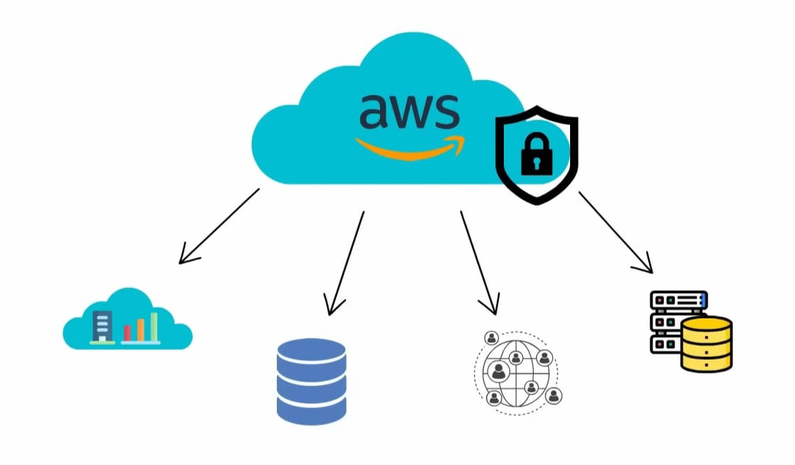
WHAT IS AWS
Amazon Web Services (AWS) is a secure cloud services platform, offering compute power, database storage, content delivery and other functionality to help businesses scale and grow.

Slide 15
ADVANTAGES OF AWS
SECURITY: AWS provides secure robust security features including encryption, access control and making suitable for sensitive data.
EXPERIENCE: You can benefit from the infrastructure management experience.
FLEXIBLE: With a wide range of services(computing, storage, databases, ML etc) AWS provides flexibility to choose the right tools for your needs.
EASY TO USE: Users can host applications quickly and securely.
SCALABLE: AWS allows you to easilybscale your resources up or down based on demands ensuring you only pau for what you use.

Slide 16
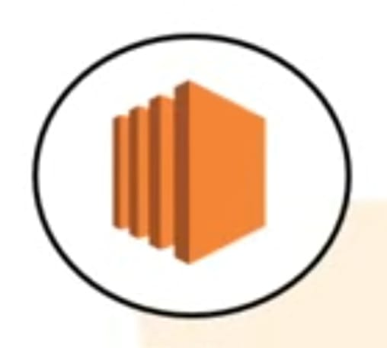
AWS SERVICES
1.Amazon EC2
Amazon EC2 (Elastic Compute Cloud) provides scalable computing capacity in the cloud.
Here are the key roles it serves:
1. Scalability and Flexibility- It allows organizations to scale their compute resources up or down based on demand.
2. Cost Management- With a pay-as-you-go pricing model, EC2 helps organizations manage costs effectively.
3. High Availability and Reliability- EC2 instances can be deployed across multiple availability zones, providing redundancy and minimizing the risk of downtime.

Slide 17

AWS SERVICES
2.S3(SIMPLE STORAGE DEVICE)
Amazon S3 (Simple Storage Service) plays a vital role in AWS by providing scalable, durable, and secure object storage for a wide range of use cases.
Here are the key roles of S3
Scalable Object Storage- S3 allows users to store and retrieve any amount of data from anywhere on the web.
Durability and Availability- S3 is designed for 99.999999999% (11 nines) durability and offers high availability.
Cost-Effectiveness- S3 offers various storage classes (e.g., Standard, Intelligent-Tiering, Glacier) to optimize costs based on access frequency and retrieval time, allowing users to manage their storage expenses effectively.

Slide 18

AWS SERVICES
3.VPC(VIRTUAL PRIVATE CLOUD
Amazon VPC (Virtual Private Cloud) provides a secure and isolated environment for users to launch and manage their resources.
Here are the key roles of VPC in AWS:
Network Isolation- VPC allows users to create a private network within the AWS cloud, isolating their resources from other customers.
Customizable Network Configuration- Users can define their own IP address range, subnets, route tables, and network gateways.
Internet and VPN Connectivity- Users can enable internet access for their resources through an Internet Gateway.

Slide 19

AWS SERVICES
4. Amazon Relational Database Service (RDS)
Amazon Relational Database Service (RDS) is a managed database service that simplifies the setup, operation, and scaling of relational databases in the cloud.
Here are the key roles that RDS
1.Scalability- RDS allows users to easily scale database instances vertically (by changing instance types) and horizontally (using read replicas), accommodating changing workloads without significant downtime.
2.High Availability and Durability- RDS offers features like Multi-AZ (Availability Zone) deployments, which provide automatic failover and replication for increased availability and data durability.
3.Backup and Recovery- RDS automatically backs up databases and allows point-in-time recovery, making it easier to restore data in case of accidental loss or corruption.

Slide 20


Thank you

